Slide 1
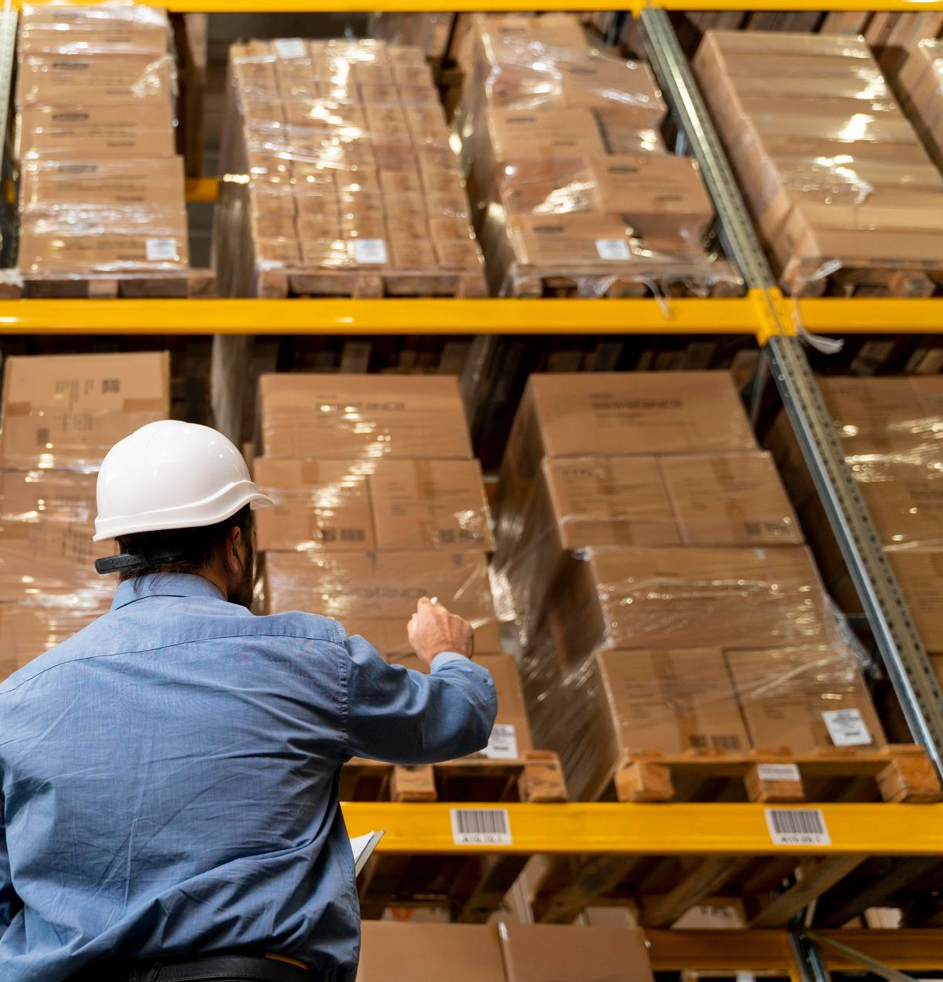

WareTech
Storage Management
Made by:
Péter Édua
Nyári Milán Bence
Niedermayer Dávid Károly

Slide 2

Team
Péter Édua: Frontend, web design
Nyári Milán Bence: Database, PM
Niedermayer Dávid Károly: Backend, Test

Slide 3
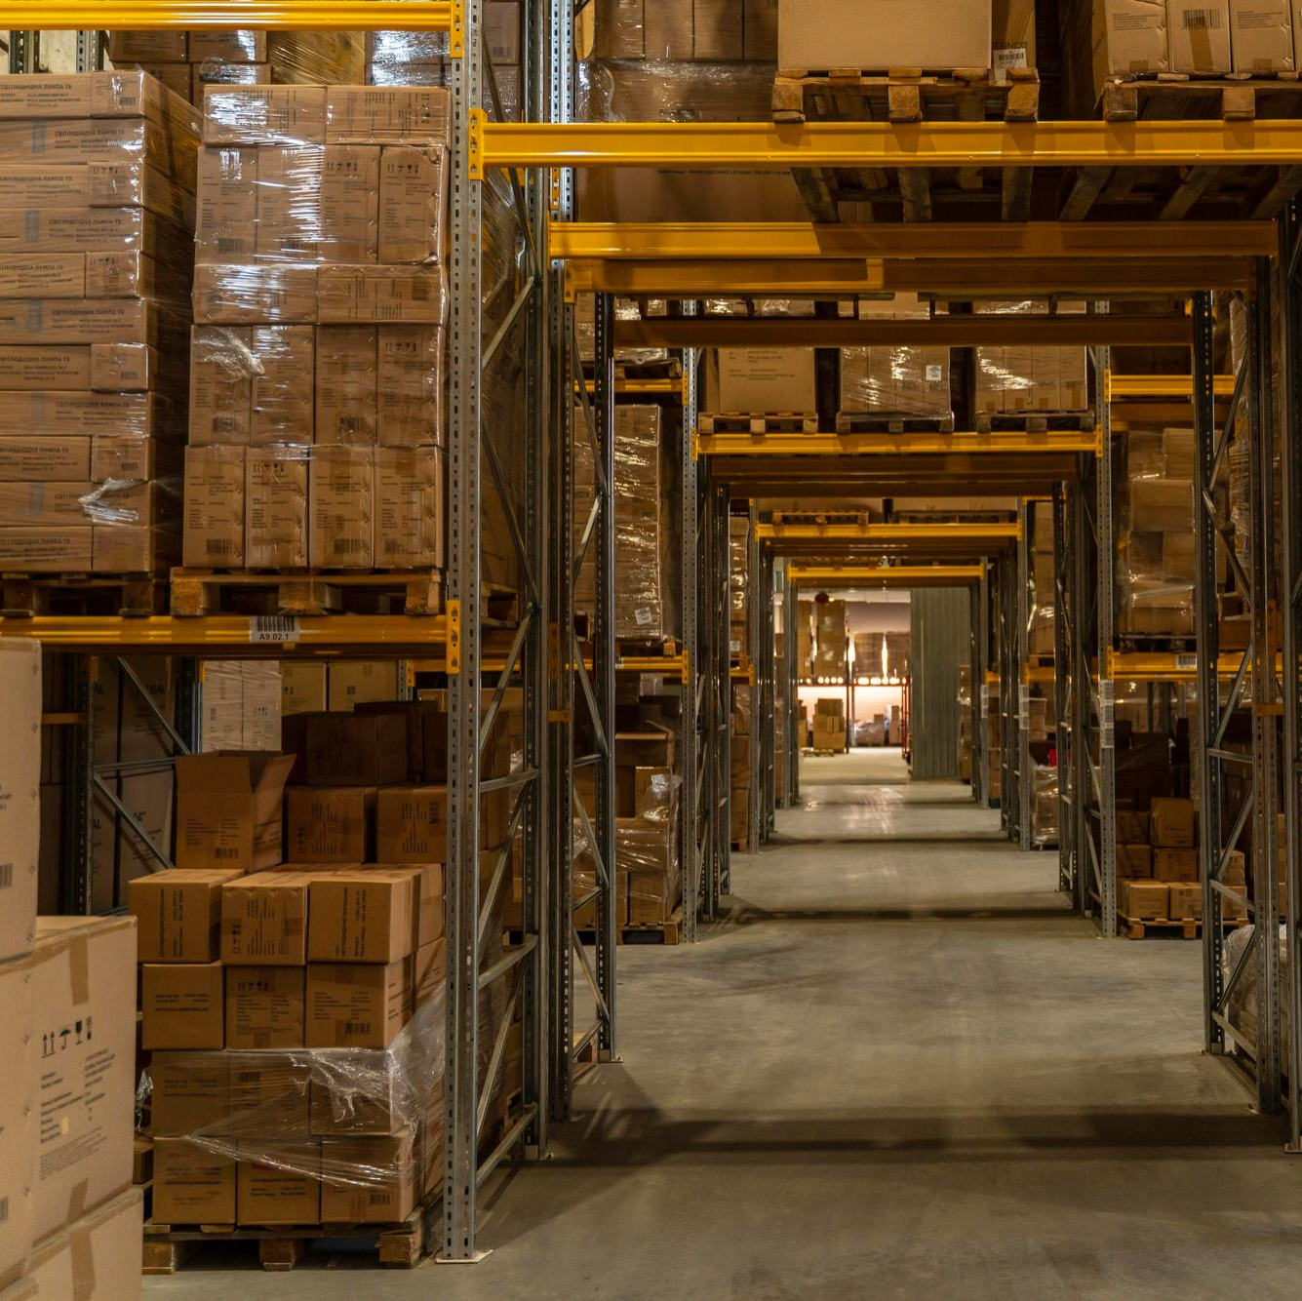
Easy management of your storage
The primary focus of the project is to address the problematic management and location determination of warehouse inventory, an issue faced by many companies.
This web application is designed to enhance the organization and efficiency of logistics operations within the given warehouse.

Slide 4
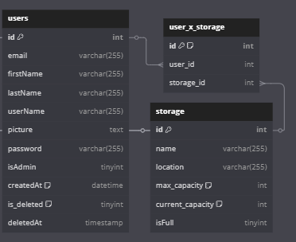
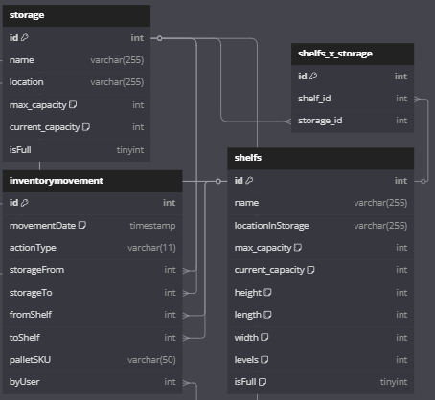
Database
Users
The workers are assigned to specific warehouses where they work, and thus they are linked to the storage. A junction table connects them together.
Storage
The Warehouse is linked to the Shelves, as every Shelf is associated with a specific Warehouse. The InventoryMovement table logs the pallet movements between Shelves and Warehouses, which is why they are related.

Slide 5
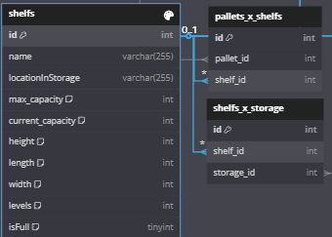
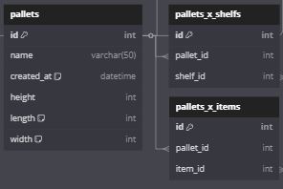
Pallets
Pallets are related to items because we manage items in pallet quantities that are then placed on shelves, creating a connection between them.
Shelfs
The connection between shelves and pallets comes from the assignment of each pallet to a specific shelf, while each shelf is, in turn, assigned to a particular storage area. This setup creates a network of relationships among them, which enhances the transparency of the warehouse.

Slide 6
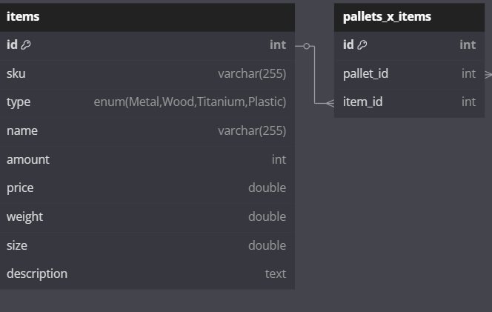
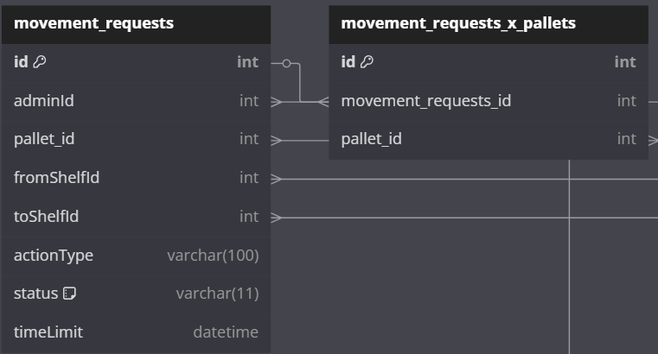
Movement requests
A movement requests the storage of tasks assigned to workers, which are associated with pallets, to be subsequently processed and acted upon.
Items
The items are only related to the pallets because we work only with pallets, not with individual items.

Slide 7
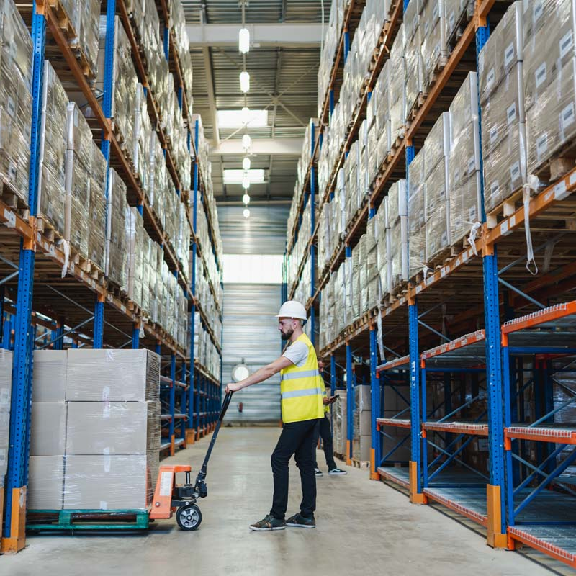
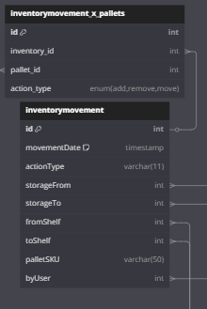
Inventory Movement
The inventory movement table is set up to keep track of all pallet movements within the system, recording information such as the type of pallet involved and the person who carried out the movement.

Slide 8
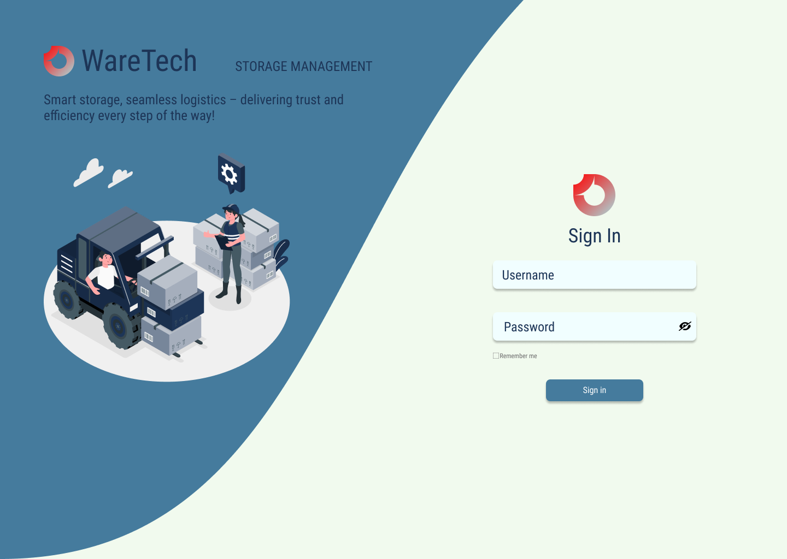
Design
Login
The login page is made to be simple, clean, and easy to use. It has a 'Show Password' option to help people log in without trouble. We also use a 'Remember Me' function to make logging in even easier. We didn’t add a 'Forgot Password' feature because this is an internal company tool, and the administrators can take care of user accounts and password resets quickly

Slide 9
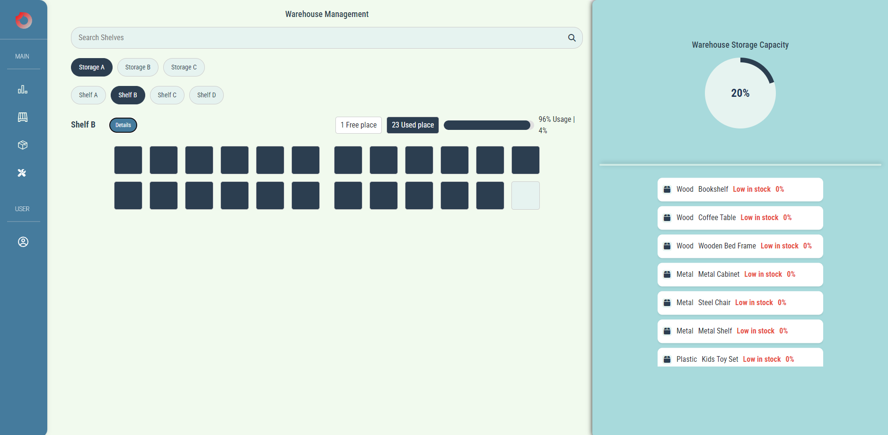
Storage overview
This page displays the shelves in the warehouse. The fullness of the shelves is shown with dark blue colors. There is a section that calculates the percentage of the warehouse’s total capacity. It also shows how much space is available and how much is full. On top of that, it highlights which types of items are running low in stock.

Slide 10
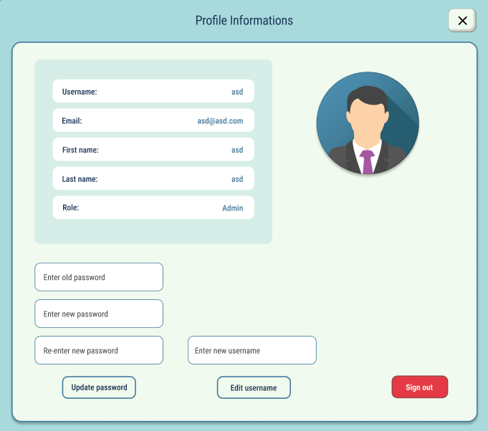
Profile
The profile is designed as a popup window. It shows the user’s details and their permission level (User or Admin). It includes options to update the password and username, allowing users to refresh their information. Additionally, a logout button is placed here for easy access.

Slide 11
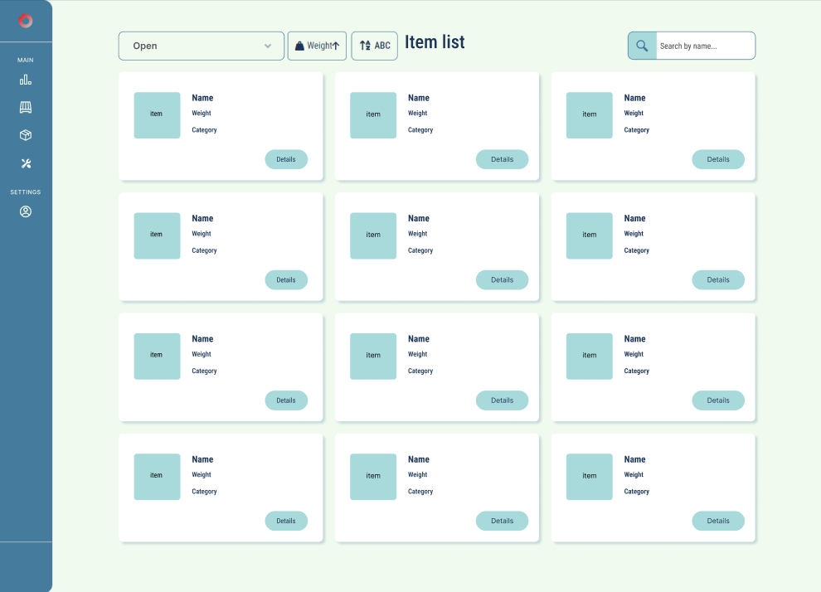
Item list
The Item List page displays cards for all the items our warehouse can store. It includes sorting buttons to organize items by weight or name. There’s also a dropdown menu that lets users categorize items by material.

Slide 12
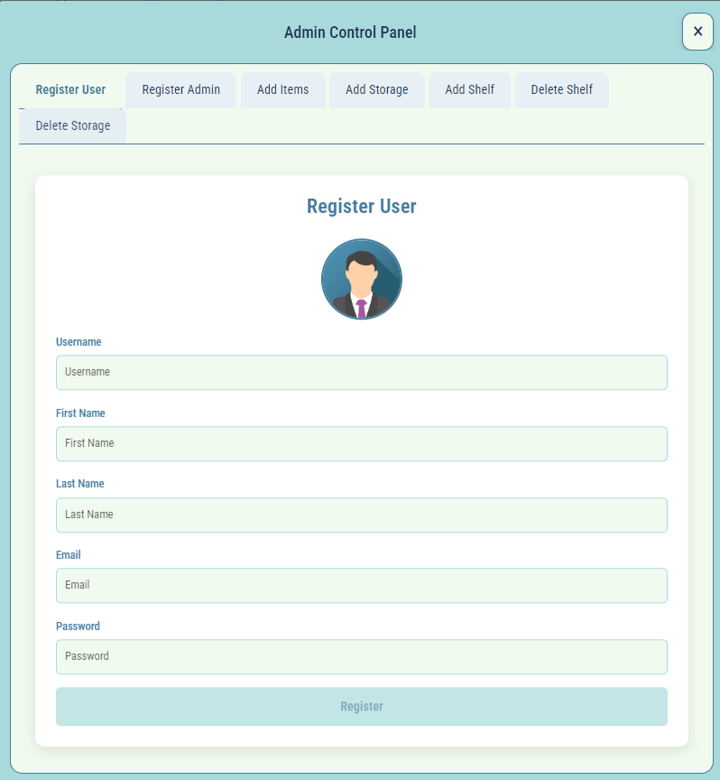
Admin panel
This panel is a popup window that holds all the admin functions for easier management. From here, admins can register users, add storage, create items, and more.

Slide 13
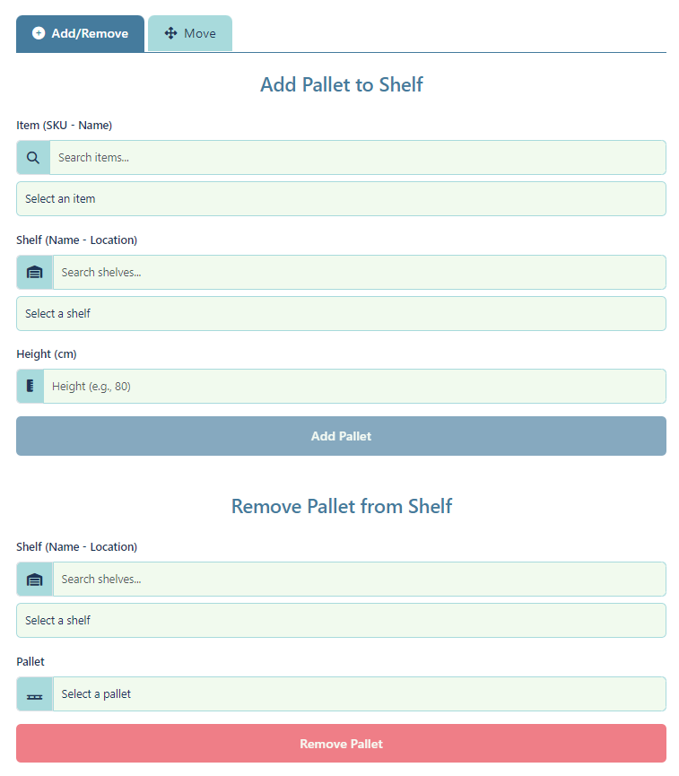
Pallet management
Pallets will be assigned to shelves by submitting their SKU codes. This way, all data can be transferred to the pallet based on its SKU. The menus for adding and deleting pallets make it easy to locate and manage the items you want to work with.

Slide 14
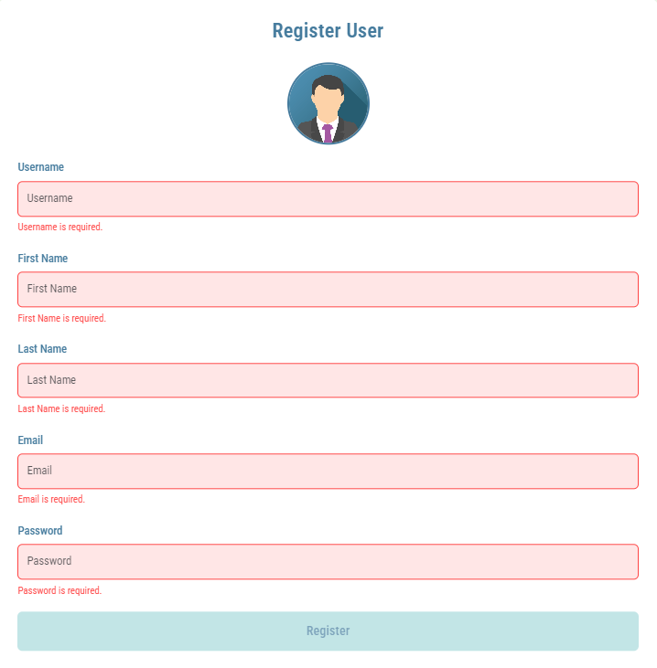
Forms
We use reactive forms to handle errors effectively and improve user-friendliness. It improves testability it enchances controll, but it can be an overkill for smaller forms since it is less declarative.

Slide 15
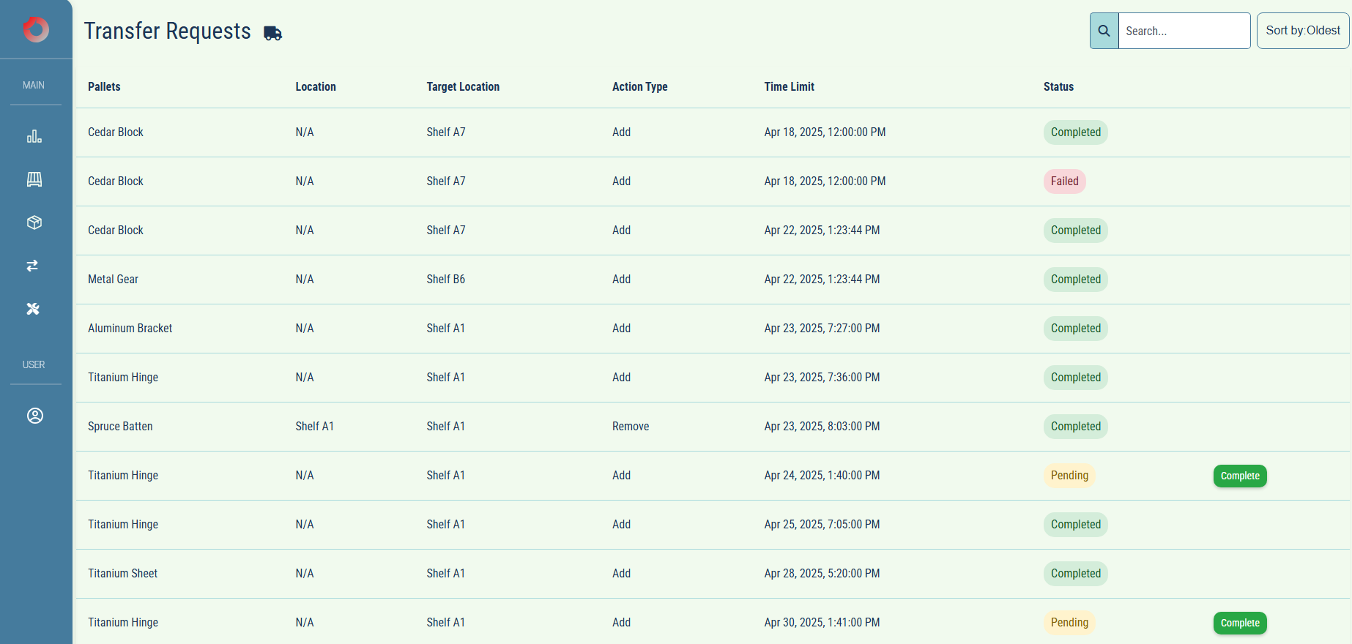
Transfer Requests
Our transfers are listed on this page and the tasks can be managed by the workers, they can complete them, but if the time runs ou the task will fail

Slide 16


Work logging and version controll system
We have been using jira’s clockwork addon to log our worktime on certain tasks so we can overview the time spent on the project and the worktime of the team members
For a version controller, we used GitHub to manage our project's source code, track changes, and help collaboration through pull requests and code reviews

Slide 17
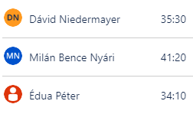
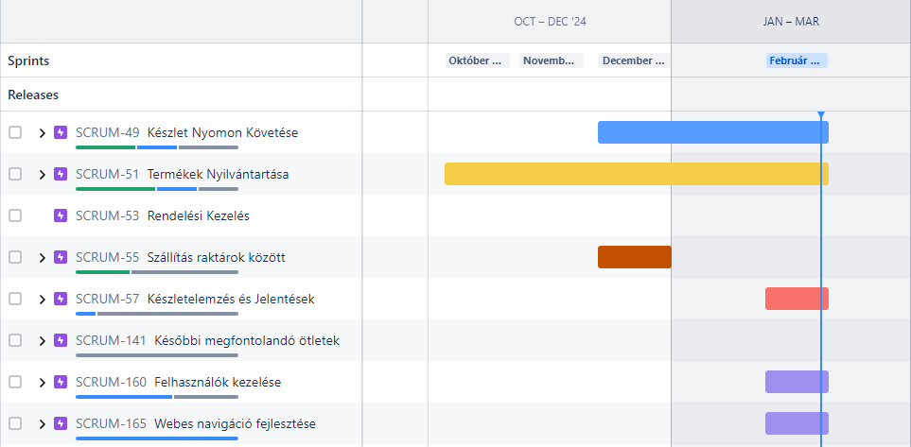
Worklogs
Our team has stayed equally consistent with the work plans we discussed, ensuring progress across all tasks.

Slide 18
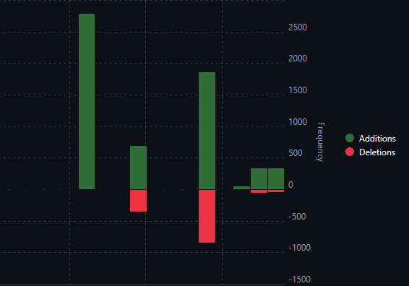
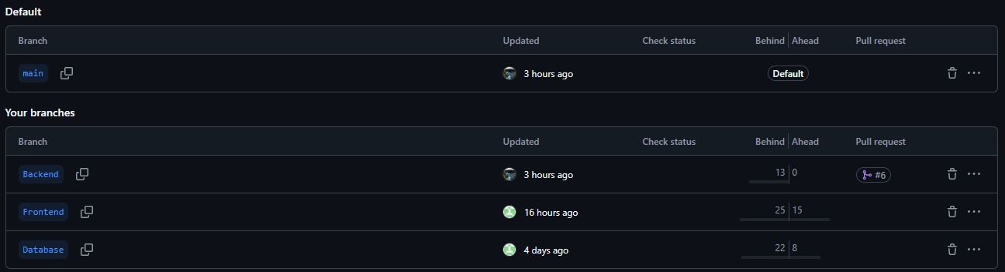
Git frequency and commits
Throughout the project, our team has committed changes after every major or valuable update. This ensures that no code is lost if something goes wrong.

Slide 19





Technologies
Maven: Manages dependencies for a Java-based backend.
MySQL: Stores the data that the REST API serves.
JWT: Secures the API by providing token-based authentication.
Angular: Displays the data on the frontend with an interactive interface.
Bootstrap: Styles and makes the Angular frontend responsive and visually appealing.

Slide 20

Tests
For testing, we employed both manual testing and automated functional testing. To carry this out, we utilized the Selenium testing tool.

Slide 21
Future improvements
Streamlined Operations: Implement barcode or QR code scanning to quickly identify items, reducing errors during inventory checks or order processing.
Integrate Barcode or QR Code Support
Refine User Permissions and Roles
Granular Access Control: Introduce additional user roles (e.g., warehouse staff, managers) beyond the existing administrator and regular user classifications. This allows for tailored permissions, such as restricting warehouse staff to inventory tasks while granting managers access to analytics.

